Slide 1
111學年度大學部專題競賽
Semi-Automated Auxiliary Penetration Testing Tool
歐家秀 108062338
徐 祈 108000232
梁家燕 108062337
莊晴雯 108062281
林姸廷 108060017

Slide 2
CONTENT
01
Introduction to Penetration Testing
02
Research Motivation and Objectives
03
Overview of Related Research
04
Design and Architecture
05
Results
06
Conclusion
07
Q&A

Slide 3
PART 1
Introduction to Penetration Testing

Slide 4

Introduction to Penetration Testing
Target reconnaissance, and attempt to breach victim systems using hacker’s mindset, conduct vulnerability exploitation, evaluate system architecture and security, finally, the tool will provide reporting and remediation.
Remediation
Vulnerability
Exploitation
Reconnaissance
Notes:
什麼是滲透測試呢?
滲透測試可以簡單理解成資安軍事演習，以駭客思維嘗試攻破受害者系統，嘗試不同弱點組合，然後評估系統結構與安全性，最後針對漏洞進行回報與修補。

Slide 5
PART 2
Research Motivation and Objectives

Slide 6


Research Motivation and Objectives
Q
After an experienced penetration testing employee resigned from a company, it caused difficulties in bridging the gap for new employees' technical experience.
Goal
Store penetration testing steps in tools and automate some steps to be executed automatically.
Notes:
如果可以有個工具，儲存滲透測試步驟，且可以自動執行部分步驟，就可以大幅解決這個問題。

Slide 7
PART 3
Overview of Related Research

Slide 8
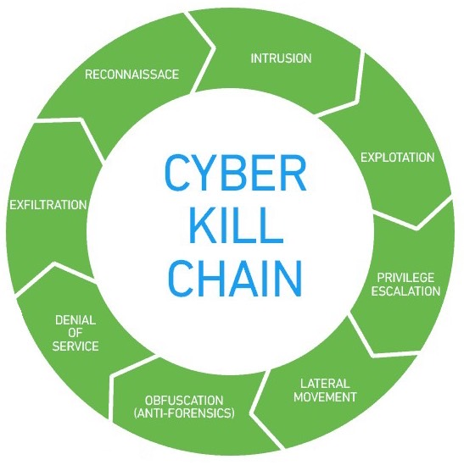

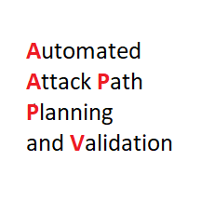
Overview of Related Research
Decompose network attacks and defenses into easily explainable stages and patterns.
Based on real-world scenarios, propose more detailed and unified classification standards for enemy tactics and technical knowledge base.
Determine a sequence to simplify the attack process based on the target. However, it is not practical as it requires manual input of network device topology in XML format.
Cyber-Kill Chain
ATT&CK
A2P2V
Notes:
市面上沒有已知類似的滲透測試輔助工具，但我們還是有參考一些標準、概念和工具，如
Cyber-attack chain
可將網路攻擊和防禦分解成易於解釋的階段和模式。
MITRE ATT&CK® 是一個基於真實情境的敵方戰術和技術知識庫，在政府以及網絡安全產品和開源社區中，常被用來當作開發特定威脅模型和方法的基礎。
A2P2V是一款開源工具，它能讓使用者根據特定的攻擊者目標確定一組排序的攻擊序列，該工具的目的是簡化流程，以便非安全專家可以透過它得到一份清楚的攻擊報告。另外，根據事先輸入的網路設備拓譜圖和設備的資訊 (e.g. IP, protocol)，A2P2V 會算出最適合的攻擊路徑。

Slide 9

PART 4
Design and Architecture

Slide 10
Design and Architecture
Store keywords of services or protocols used in the intrusion methods and prioritize the recommendation of attack chain execution based on keywords in different scenarios.
tag
tag
Block Chain
Block 1
tag
Block…
Block n
Read
attack chain
Class Chain
Class 1
Class…
Class n
Notes:
儲存了入侵方式使用的服務或協定等關鍵字，可依據關鍵字在不同的場域中優先推薦不同的 attack chain 執行。
另外也參照物聯網評估指引劃分了 PT(Penetration Testing) 種類，作為工具執行完畢後產出的 report 中的場域評估指標。

Slide 11
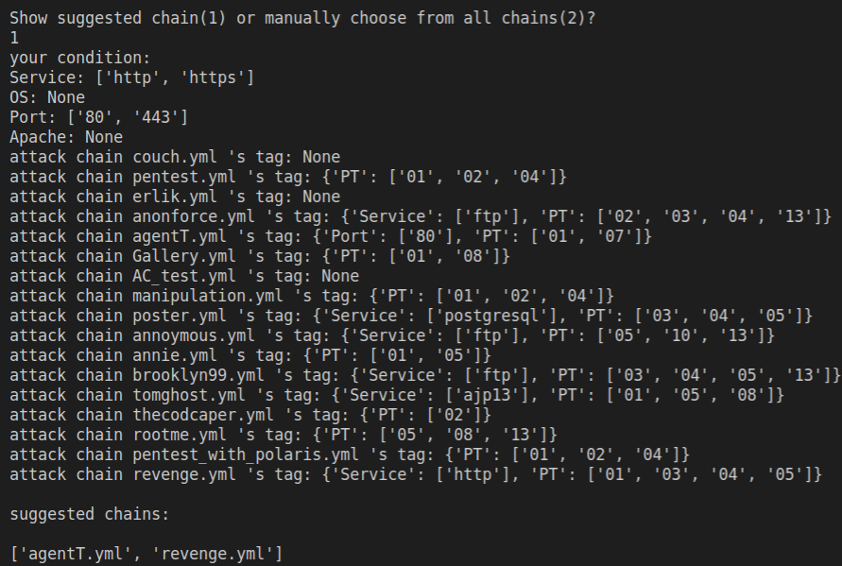
Design and Architecture
tag
tag
Read
attack chain
tag

Slide 12
Design and Architecture
Choose mode
Run Single block
Select Chain
Execute Chain
Privilege Escalation
End Exploring
Generate Report

Slide 13
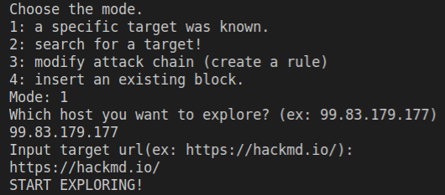
Design and Architecture
Choose mode
Run Single block
Select Chain
Execute Chain
Privilege Escalation
End Exploring

Slide 14
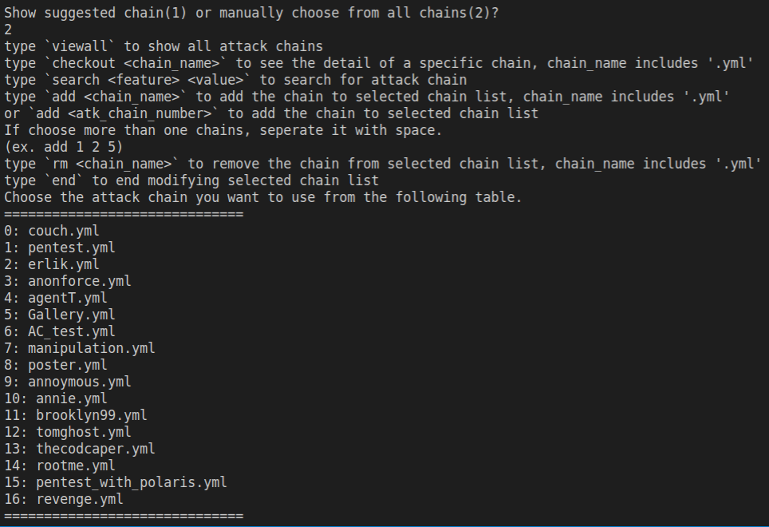
Design and Architecture
Choose mode
Run Single block
Select Chain
Execute Chain
Privilege Escalation
End Exploring

Slide 15
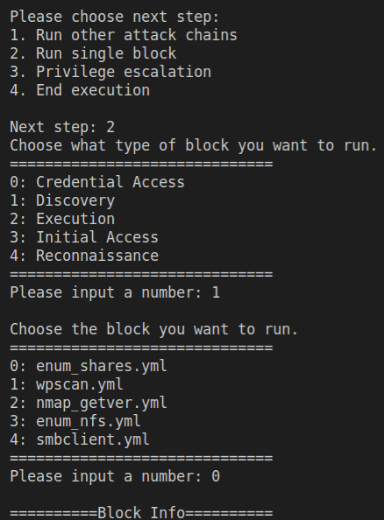
Design and Architecture
Choose next step
Run Single block
Choose block type
Execute Chain
Privilege Escalation
Choose single block
End Exploring

Slide 16
Design and Architecture
Execute Chain
User Input
User Input
User Input
Missing Data
Get Data
Block Chain
Block 1
Match Rule
Block…
Block n
End Execution
Read
attack chain
Mismatch Rule
Class Chain
Class 1
Class…
Class n
Mismatch Rule

Slide 17
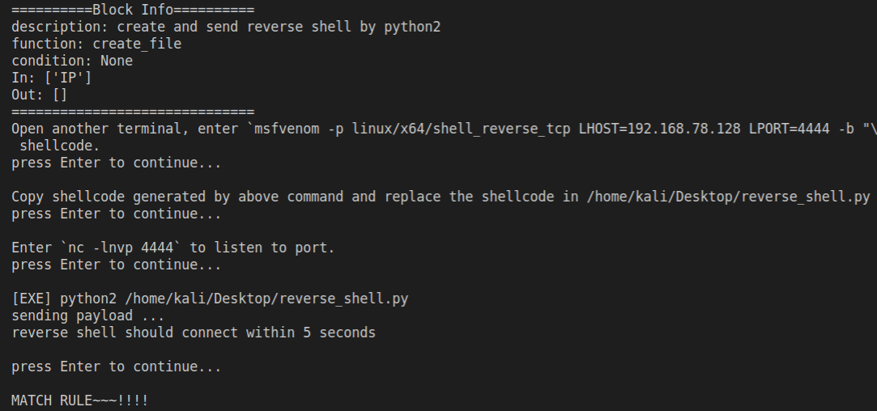
Design and Architecture
Run Single block
Privilege Escalation
End Exploring
Generate Report

Slide 18
PART 5
Results

Slide 19
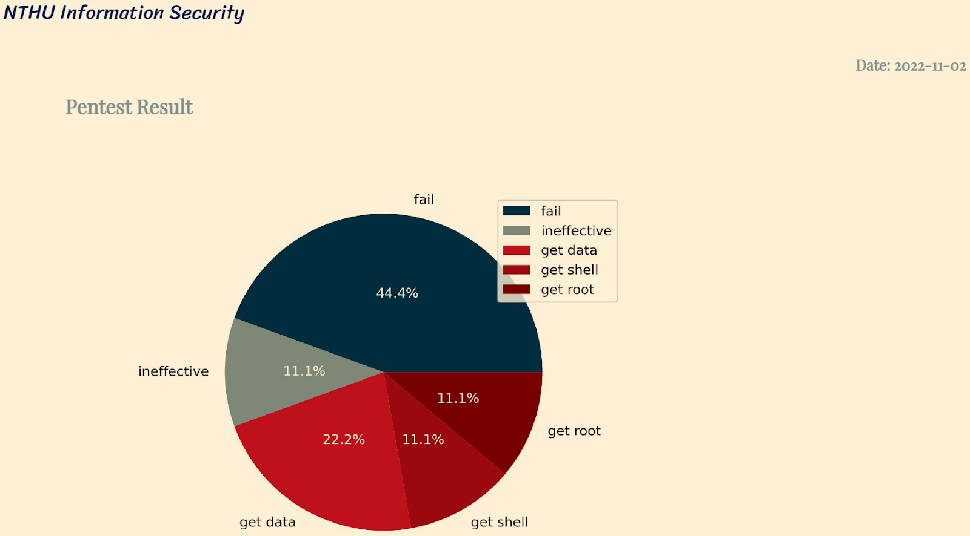
Results
Penetration testing results, divided into 5 categories

Slide 20
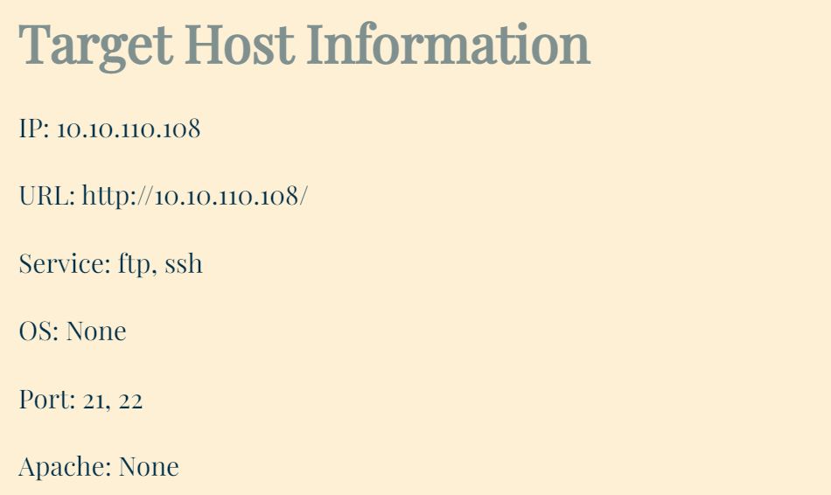
Results
滲透測試結果，共5類
Information on the penetration testing target

Slide 21
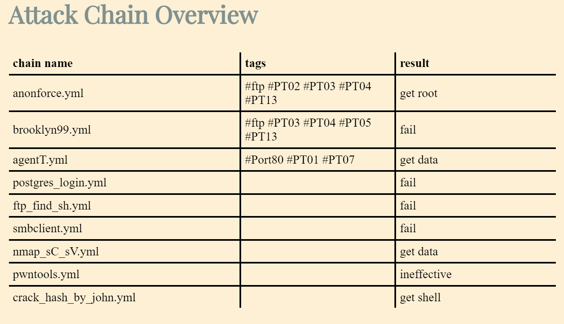
Results
Penetration testing (PT) types in the Security Assessment Guidelines for IoT-enabled field applications by TAICS
Attack chain name
Notes:
台灣資通產業標準協會-TAICS

Slide 22
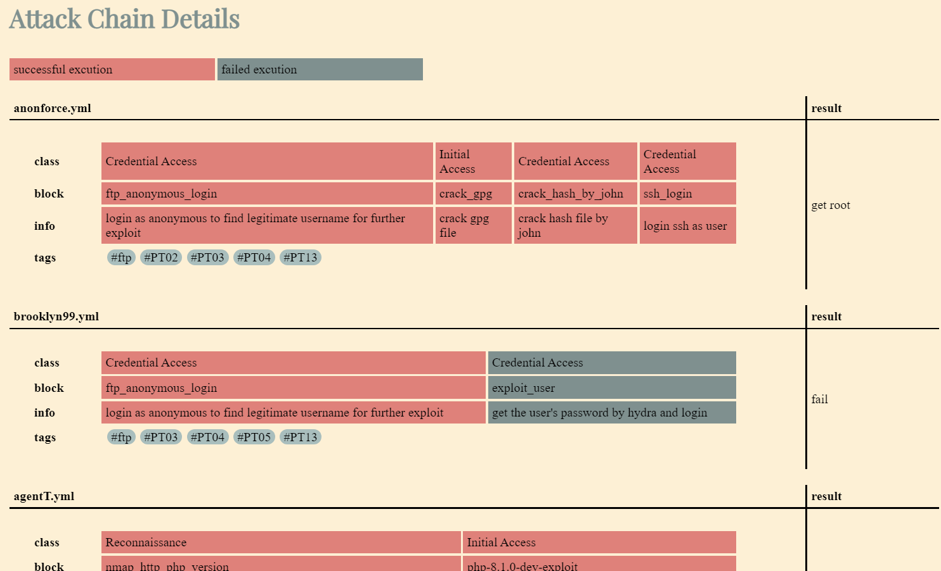
Results
Red: Attack chain successfully executed
Gray: Attack chain execution failed

Slide 23

PART 6
Conclusion

Slide 24
Conclusion
Development Achievements
The tool can integrate with built-in tools in Kali Linux.
Allows users to explore the domain.
Generator function is used to facilitate users in adding attack chains.
Automated execution of commands or prompts to assist penetration testing.
Provide a report for users to evaluate the results.
Future Outlooks
Become an open-source project, open to more user contributions of attack chains.
Provide more reference materials for beginners who are new to penetration testing techniques.

Slide 25
PART 7
Q & A

